Slide 1
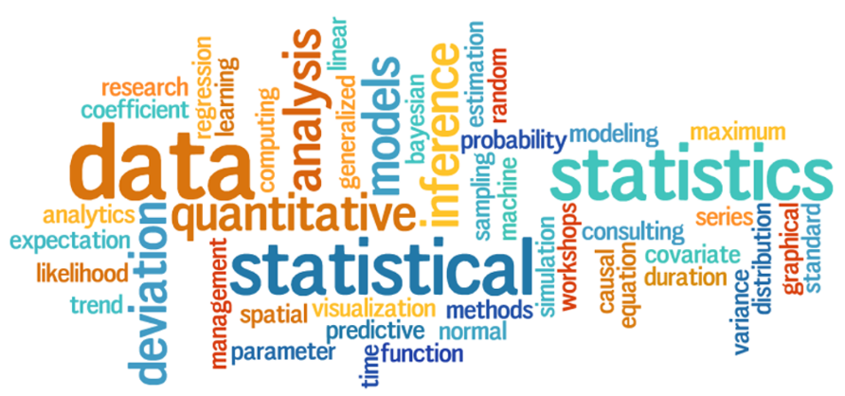

My Statistics Interactive Notebook
Name:
Class: 9-9
Teacher: Mr Evans
Term 3 Semester 2

Slide 2


Slide 3
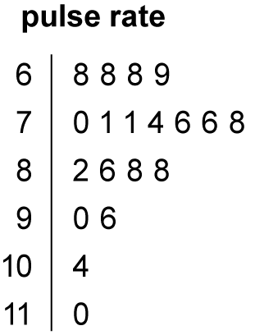
Warm Up
Are these Stem and Leaf Plots skewed, positively, negatively or are they symmetrical?
1.

Slide 4


2.
3.

Slide 5

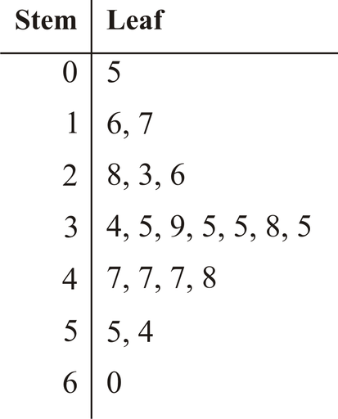
4.
5.

Slide 6
Answers.
Positive
Negative
Negative
Positive
Symmetrical

Slide 7
24
7
30
Date
Sources of Data
EQ – What are the different sources of data and how do we classify them?
What are the different
sources of Data?
Primary Sources
A primary source provides direct or firsthand evidence about an event, object, person, or work of art. Primary sources include historical and legal documents, eyewitness accounts, results of experiments, statistical data, pieces of creative writing, audio and video recordings, speeches, and art objects. Interviews, surveys, fieldwork, and Internet communications via email and blogs are also primary sources.
Secondary Sources
Secondary sources describe, discuss, interpret, comment upon, analyze, evaluate, summarize, and process primary sources. Secondary source materials can be articles in newspapers or popular magazines, book or movie reviews, or articles found in scholarly journals that discuss or evaluate someone else's original research.

Slide 8
Complete the exercise on Primary and Secondary Data. Use your notes if you need to.

Slide 9
Complete your Summary ensuring you explain the difference between Primary and Secondary sources of Data.

Slide 10
Notes Review
24, 7 ,30
Date
Title
Essential question
Notes complete
Notes complete with colour and diagrams
Questions completed
Contents page filed in
Formula page filled in

Slide 11
Homework
Review your notes and write a summary answering the essential question.

